Slide 1
Technical team

Slide 2
Week 1
The only relaxed week in the internship. ☺
Learned Git and its usage.
Made a static CoughLoud website using Bootstrap.

Slide 3


Slide 4
Week 2
Made a static CoughLoud website using Bootstrap.
Aditya- Presentation on Designer-Developer Handoff.
Aditya- Made a Spotify player on terminal using python.
Bhupi - Start making a Spotify player (but didn't complete....:))
Rishu - Design an app by flutter
https://drive.google.com/file/d/1CQMMTd6E95vJKB3AXNE7TAqbYdixPwBe/view

Slide 5


Slide 6
Week 3
Week 3:
Aditya- Made a presentation of the basics and implementation of firebase.
Bhupi - Started a ML course- with 4 parts (with a goal of completing it in one week)
ALL – Learned the concepts of tensorflow. Bhupi worked on it in much detail.

Slide 7
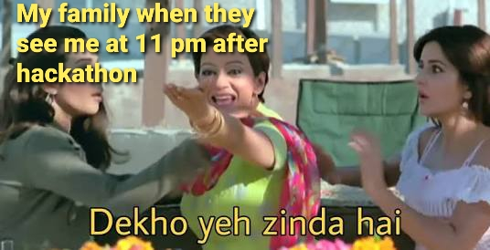

Slide 8
Week 4
Week 4:
CoughLoud Project begins :)
Aditya and Rishu: Learned the basics of Vuejs, some basic and advanced concepts of HTML, CSS and Javascript. Also learned how to make a design responsive.
Bhupi - I know one week is completed but still continuing previous ML course. :)
Introduction of attendence system.

Slide 9
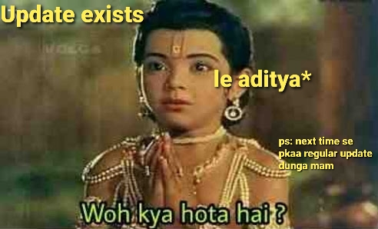

Slide 10
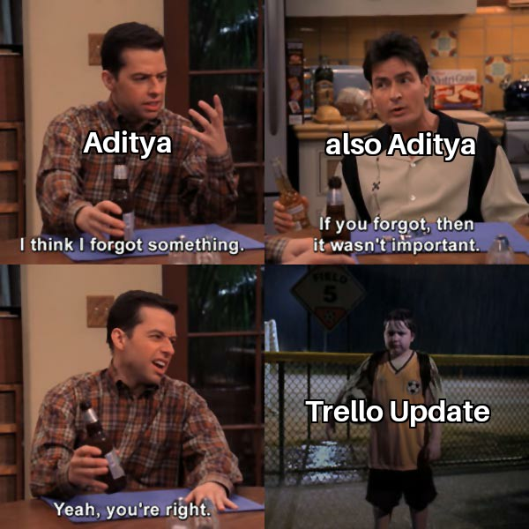

Slide 11
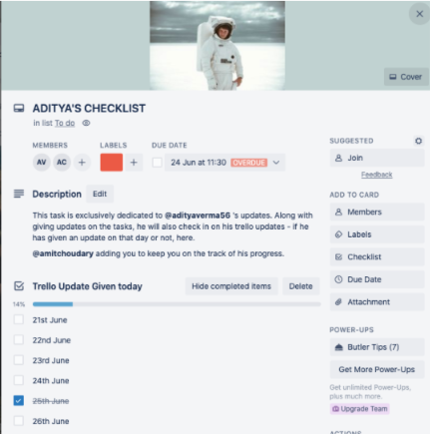

Slide 12
WEEK 5
Week 5:
CoughLoud Project going on:
Aditya and Rishu: Designed the front end of coughloud wireframes and started learning about the backend.
Bhupi: Design an ml model to classify whether it is a cough or not

Slide 13
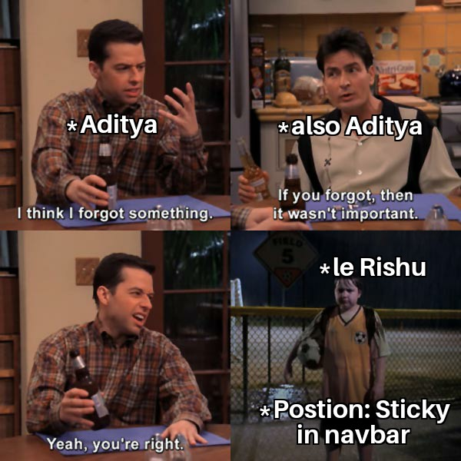

Slide 14
Week 6
Week 6:
CoughLoud project going on and along with hackathon.
Aditya and Rishu:
Front end is completed both for mobile and laptop version. Most of the backend was completed.
Bhupi: worked on preprocessing of cough data

Slide 15
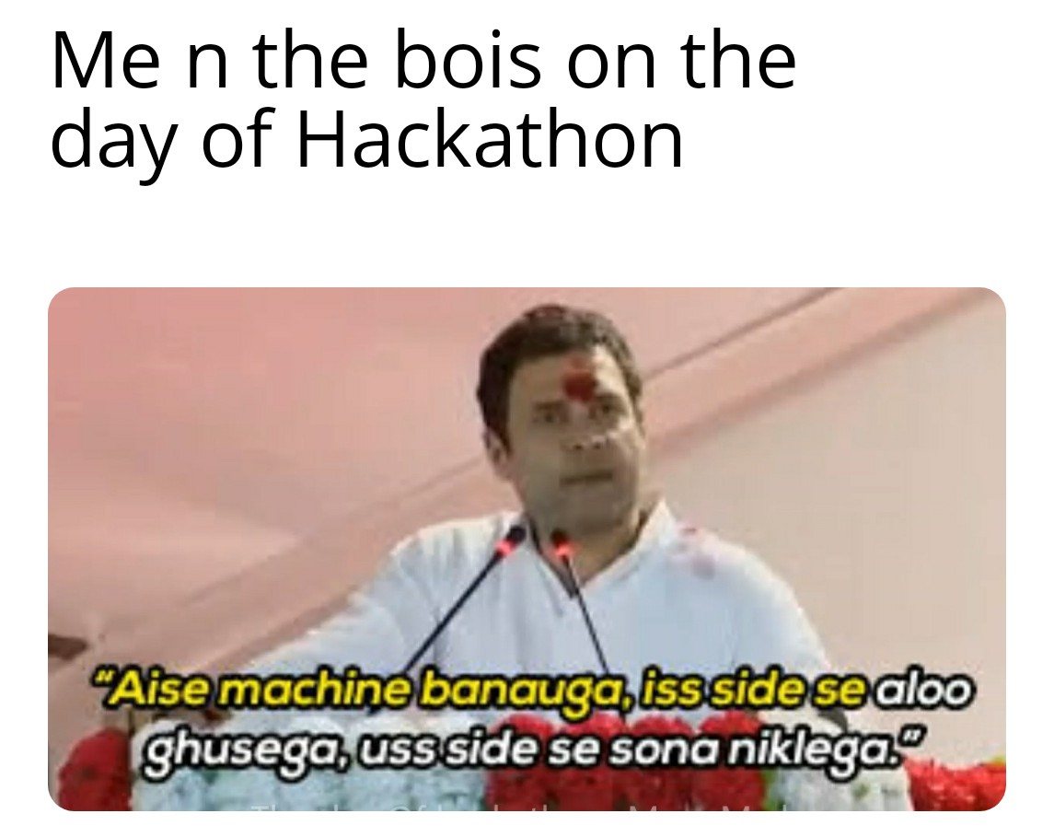

Slide 16
Week 7
Week 7:
Aditya and Rishu: Wireframes for impact calculator was given. Design the front-end and backend both. The project was almost completed. Just after final touch, and after the feedback, the project was completed.
https://impact-calculator-78a7c.web.app/
Bhupi: basic architecture of model was completed now started dealing with data collected by rishu and aditya to make final model

Slide 17


Slide 18
Week 8
Integration of AI model on CoughLoud Project
Aditya and Rishu: learning curve towards deployment of ml model. Integration of ml model on our coughloud project.
Databank project in progress.
Avakar website in progress.
ALL- Deployed ml model. Tried many different ways but none was successful After deploying 50-60 versions and trying many things, finally the model was deployed; made a technical documentation of the same
Technical Documentation- https://docs.google.com/document/d/19dIkYIrRPBVhtaEiMUdm5mS4z532TjaG2DNBIf86efs/edit

Slide 19
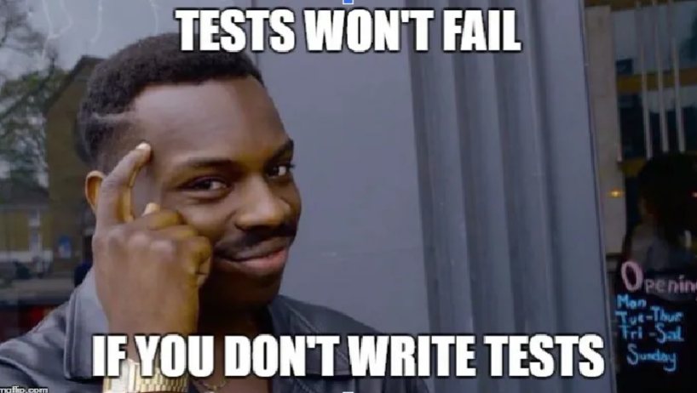

Slide 20
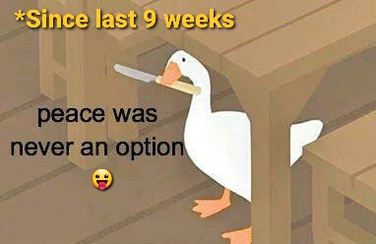

Slide 21
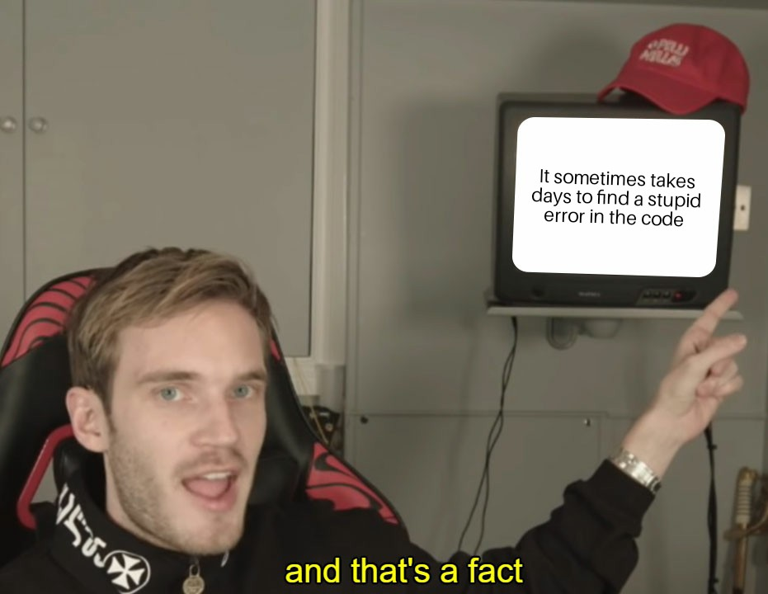

Slide 22
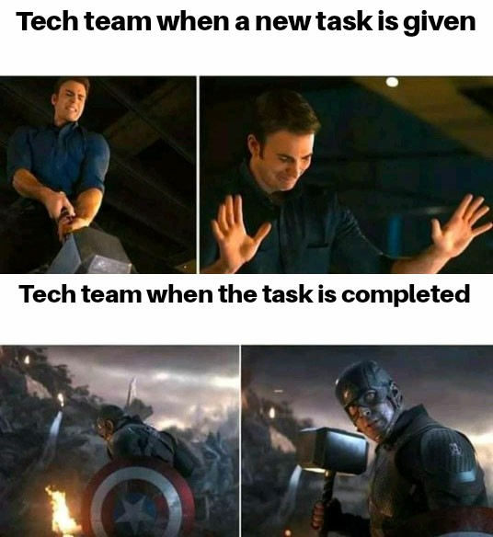

Slide 23
CoughLoud 1.0 -
https://silent-window-273817.web.app/
CoughLoud 2.0 –
https://coughloud.healthwin.in/

Slide 24
Thank You

